Slide 1
Partial Classes
Presented by Ester Ding

Slide 2
What is Partial Classes
Split a class, struct, method or interface in multiple .cs files
Using the partial keyword
Complier will combine when program is complied

Slide 3
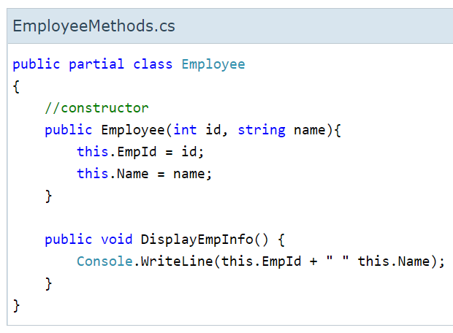
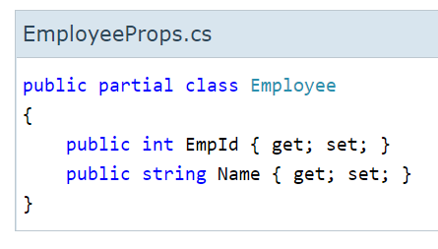
What is Partial Classes

Slide 4
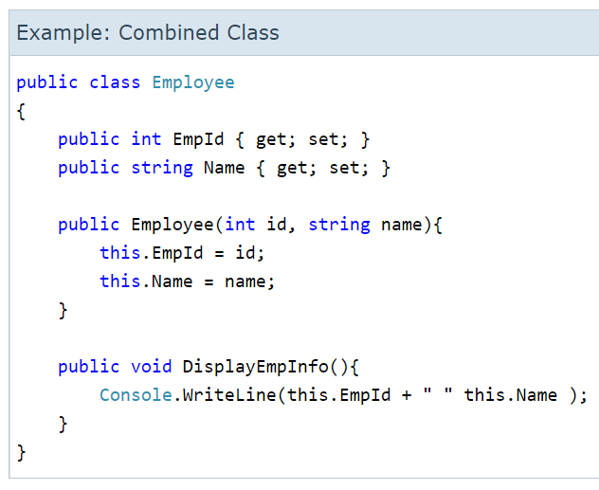
What is Partial Classes

Slide 5
When to Use?
working on large projects
working with automatically generated source
using source generators to generate additional functionality in a class

Slide 6
Restrictions
All partial-type definitions meant to be parts of the same type must be modified with partial.
definitions must be in the same assembly and namespace
all the parts must have the same accessibility (public or private, etc.)
the partial modifier can only appear immediately before the keywords class, struct, or interface

Slide 7
Restrictions
The class name and generic-type parameters must match on all partial-type definitions.
Each partial declaration must use the same parameter names in the same order.

